Slide 1
Intoduction to Rasa: An open source Chatbot Development Platform

Slide 2
Table of contents
Introduction
Understanding Chatbots
Getting started with RASA
Creating your First Rasa Chatbot
Training & Evaluating RASA models
RASA Actions & Responses
Advanced RASA concepts
Deploying RASA Chatbots
RASA X: Collaborative Development
Best Practice for Successful Chatbots

Slide 3
Introduction
What is Rasa?
  Rasa is an open-source conversational AI framework for building AI-powered chatbots and virtual assistants.
  It allows developers to create sophisticated, context-aware, and interactive chatbots that can handle complex conversations.
Why Rasa for Chatbot Development?
  Flexibility: Rasa provides complete control over the chatbot's behavior and responses, enabling customized user experiences.
  Open Source: Being open source, Rasa offers transparency, community-driven contributions, and no vendor lock-in.
  Scalability: Rasa can scale from small prototypes to large, production-ready deployments.
Key Features and Advantages
  Natural Language Understanding (NLU): Extracts intents and entities from user messages.
  Dialogue Management: Manages the flow of conversations using machine learning-based dialogue policies.
  Open and Extensible: Allows integration with external APIs and libraries for seamless functionalities.
  Rasa X: Collaborative development tool for version control and user feedback.

Slide 4
Understanding Chatbots
What are Chatbots?
  Chatbots are AI-powered virtual assistants designed to interact with users via text or speech.
  They simulate human conversation and provide automated responses based on user inputs.
Types of Chatbots
  Rule-Based Chatbots: Follow pre-defined rules and responses, limited in complexity and adaptability.
  AI-Powered Chatbots: Leverage machine learning and NLP to understand and respond to user intents and context
Use Cases and Applications
  Customer Support: Chatbots provide instant assistance, resolving queries, and offering support 24/7.
  E-commerce: Chatbots help users with product recommendations, order tracking, and personalized shopping experiences.
  Information Retrieval: Chatbots deliver real-time information on weather, news, or general knowledge.
Benefits of Chatbots
  Improved Customer Service: Chatbots reduce response times and offer consistent support, enhancing user satisfaction.
  Cost Savings: Automating repetitive tasks saves resources and operational costs.
  Scalability: Chatbots can handle multiple conversations simultaneously, scaling effortlessly with demand.
Challenges
  Natural Language Understanding
  Contextual Understanding
  Emotional Intelligence

Slide 5
Getting started with RASA
Command | Effect
rasa init | Creates a new project with example training data, actions, and config files.
rasa train | Trains a model using your NLU data and stories, saves trained model in ./models.
rasa interactive | Starts an interactive learning session to create new training data by chatting to your assistant.
rasa shell | Loads your trained model and lets you talk to your assistant on the command line.
rasa run | Starts a server with your trained model.
rasa run actions | Starts an action server using the Rasa SDK.
rasa visualize | Generates a visual representation of your stories.
rasa test | Tests a trained Rasa model on any files starting with test_.
rasa test e2e | Runs end-to-end testing fully integrated with the action server that serves as acceptance testing.
rasa data split nlu | Performs a 80/20 split of your NLU training data.
rasa data split stories | Do the same as rasa data split nlu, but for your stories data.
rasa data convert | Converts training data between different formats.
rasa data migrate | Migrates 2.0 domain to 3.0 format.
rasa data validate | Checks the domain, NLU and conversation data for inconsistencies.
rasa export | Exports conversations from a tracker store to an event broker.
rasa evaluate markers | Extracts markers from an existing tracker store.
rasa marker upload | Upload marker configurations to Analytics Data Pipeline
rasa license | Display licensing information.
rasa -h | Shows all available commands.

Slide 6
Creating your First Rasa Chatbot
Set Up a New Rasa Project
  Use the command: rasa init to initialize a new Rasa project.
  This generates the basic project structure with essential files.
Define Domain, Intents, Entities, and Responses
  Create a domain.yml file to define the chatbot's domain including intents, entities, and actions.
  Add intents for user input, such as greet, goodbye, inform, etc.
  Define entities to extract specific information from user messages.
Craft Stories for Sample Conversations
  Create stories.yml to simulate sample conversations between the user and the chatbot.
  Stories represent different paths a conversation can take.
Designing Responses and Actions
  Define responses in the domain.yml file to provide bot replies.
  Implement custom actions to handle responses that require external APIs or dynamic data.
Training Your Chatbot
  Use the command: rasa train to train the NLU and Core models.
  The chatbot learns from the provided data and stories to improve its responses.
Interactive Chatbot Testing
  Run interactive mode with rasa interactive to test and correct the chatbot's responses or rasa shell.

Slide 7
Training & Evaluating RASA models
Training NLU and Core Models
  Use the command: rasa train to train both NLU and Core models together.
  NLU model learns to understand intents and extract entities.
  Core model learns to manage dialogue flow based on training stories.
Evaluating Model Performance
  Measure model performance using Rasa's evaluation tools.
  Calculate NLU model accuracy, intent classification, and entity extraction metrics.
  Evaluate Core model's dialogue predictions against test stories.
Hyperparameter Tuning
  Optimize model performance by adjusting hyperparameters.
  Fine-tune settings for NLU pipelines and Core policies.

Slide 8
RASA Actions & Responses
Rasa Actions
  Actions are the building blocks of chatbot responses.
  Each action represents a specific behaviour or response the chatbot can take.
Handling Custom Actions
  Custom actions are user-defined responses for specific intents.
  They enable the chatbot to perform tasks beyond simple text replies.
Integrating External APIs
  Actions can interact with external APIs to fetch data or perform actions.
  Connect to services like weather APIs, databases, or payment gateways.
Handling Utterances and Slots
  Utterances are user inputs, and slots are used to store extracted information.
  Combine slots and utterances to provide contextually relevant responses.
Responses Based on Entities
  Use extracted entities to tailor responses to user inputs.
  Provide relevant information or take specific actions based on recognized entities.

Slide 9
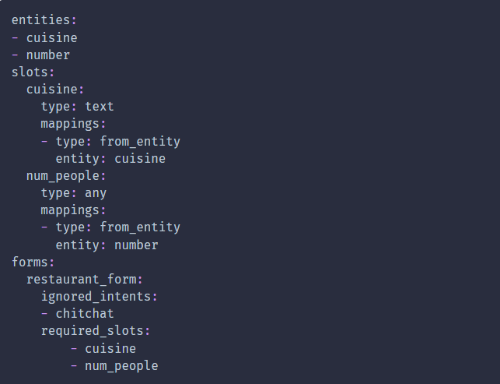
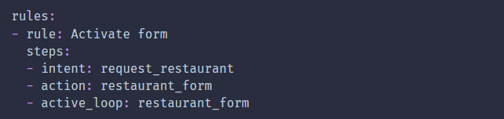
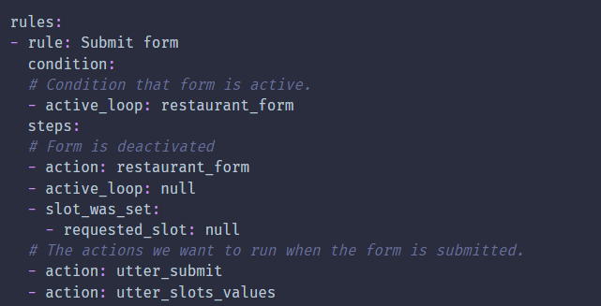
Advanced RASA concepts
Slots: slots are used to store information that the chatbot needs to remember during a conversation with a user. Rule-Based Chatbots: Follow pre-defined rules and responses, limited in complexity and adaptability.
  Types : Text, Boolean, List, Categorical, Float, Unfeaturized
Slot Mapping: The slot mapping defines how the slots are filled.
  Types: E-commerce: from_text, from_entity, from_intent, from_trigger_intent
Forms: a form is a way to collect multiple pieces of information from the user in a structured manner.

Slide 10
Deploying RASA Chatbots
Deploying Locally
  Test the chatbot on your local machine using the Rasa command line interface.
  Interact with the chatbot through the command prompt.
Deploying to Cloud Services
  Deploy the chatbot to cloud platforms like AWS, Azure, or Google Cloud.
  Use Docker or serverless technologies for scalability and flexibility.
Web Chat Integration
  Embed the chatbot into websites for direct user interaction.
  Use Rasa Webchat or custom UI integration.
Messaging Platform Integration
  Integrate the chatbot with popular messaging platforms like Facebook Messenger, Slack, or WhatsApp.
  Use Rasa Connectors to enable communication with these platforms.

Slide 11
RASA X: Collaborative Development
What is Rasa X?
  Rasa X is a powerful tool for collaborative chatbot development and management.
  It provides a user-friendly interface to streamline the end-to-end chatbot development process.
Features
  Version Control and Collaboration.
  Collecting User Feedback and Annotating Data
  Annotating and Correcting Conversations
  Continuous Model Training and Testing
  Secure Sharing and Access Control

Slide 12
Best Practice for Successful Chatbots
Designing User-Centric Conversations
Handling NLU Challenges
Managing Context and State
Providing Clear Responses
Emphasizing Security and Privacy
Regular Testing and Quality Assurance
Continuous Improvement and Updates

Slide 13
Thank you!

